Slide 1

Project Status Team Eagle
SSW695 – Spring 2024

Slide 2
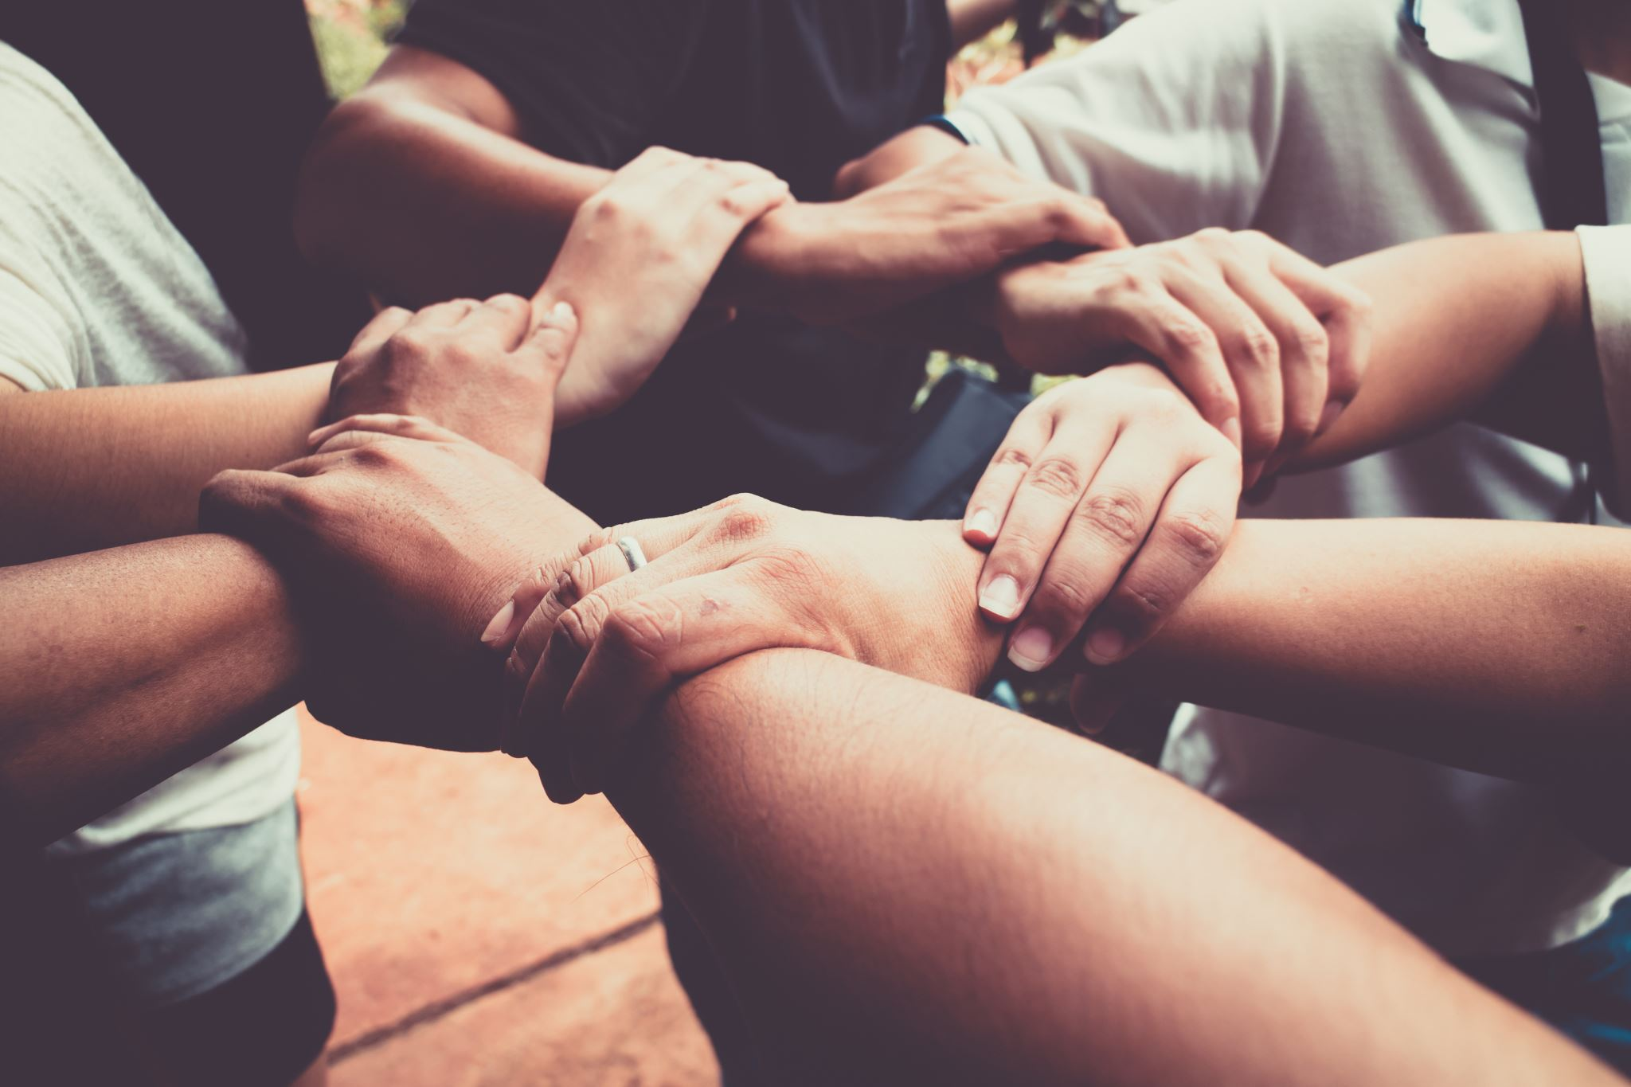
Team Members
Robert Hernandez
Jashil Mehta
Meet Rajeshkumar Jain
Ishan Sanjaykumar Patel
Aayushi Hemanshu Desai

Slide 3

Agenda
Sprint 2 User stories
Current Status
Completed Tasks
Future Sprints
Lessons Learned
Demonstration
Mockups
Demo

Slide 4
Sprint 2 User Stories
User story #5 (Update item found). This feature aims to provide the opportunity to whoever created the missing report to update from "missing" to found" or potentially update any detail of the selected report.
User story #6 (Search for missing items). This feature aims to display a table of all the missing items, and by adding some search criteria, the user can narrow it down to specific requirements.
User story #12 (Login). This feature aims to allow users to log into their accounts and use the tool's different capabilities based on user type (e.g., create missing reports, add details to reports, revoke access to the system).
User story #13 (Develop signup back-end logic). The end goal is to have a fully working logic that allows the admin to insert a new user into the database.
User story #9 (Encrypt Password)—Tentative. If the team has enough time, the goal for this sprint is to add an encryption algorithm to secure the password inserted on the login page.

Slide 5

Current Status
The team is currently working on the assigned user stories for sprint 2. These include the following:
Develop the login page (Robert)
Protect user password (encryption)
Search for a missing item (Aayushi)
Update a missing item (Aayushi)
Add new user to database (Robert)
In addition to the tasks mentioned above, our front-end team is helping along the way in developing the user interface
Ishan and Meet
Jashil is helping the team with AWS integration.
Currently working/investigating how to deploy the application.

Slide 6

Completed Tasks
The following tasks the team was able to complete successfully.
User Story #1 (Create a missing item report)
User Story #2 (Add details about the missing item report)
Preliminary database created.
pgadming (PostgreSQL) set up
AWS PostgreSQL connected (up and running)
Landing page
Connection between front & back end established
User Story #12 (Login)
Logic created but currently going under tests.
“basic approach”
Our goal is to ensure that the basic structure is fully working so that we can build up from there.

Slide 7

Future Sprints
As we keep moving forward, the team is producing more ideas and potentially removing some (expected).
Sprint 3 & 4:
The goal is to set up the admin and regular user fully.
Admin side:
Be able to have more control of the system. (Revoke/grant access, update the status of the missing item, create an account for a user)
Regular user
All the main features to be fully functional. (Create a report, update it, delete it, search for it)
Ability to notify the user (account revoked/granted, item found)
Brainstorming
Security

Slide 8


Lessons Learned
Without a doubt, this has been a journey, and it is interesting how much one can learn in such a short time.
Time management
Communication
Adaptability
Collaboration
Flexibility

Slide 9

Demonstration
Demo
Mockups

